Slide 1
Advocating for Students: Public Policy as a Core Competency for All Student Affairs Professionals
Teri Lyn Hinds
Director, Policy Research and Advocacy
Diana Ali
Policy Analyst
Notes:
Welcome to Careers in Student Affairs Month! We get the honor of kicking off NASPA’s month-long webcast series to help explore the many and myriad career options in and around higher education campus student affairs.

Slide 2
Welcome!
PLEASE MINIMIZE ALL OTHER APPLICATIONS AT THIS TIME
Just a few technical notes before we begin…
Notes:
Please at this time minimize all other applications so that you can see and hear our presentation today. Our session today is short, but I will leave time for questions at the end, which you’ll need your keyboard to enter, so you’ll want to keep that handy.

Slide 3
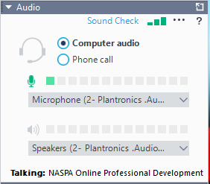
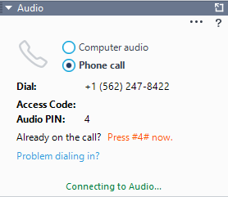
Welcome!
PLEASE MINIMIZE ALL OTHER APPLICATIONS AT THIS TIME
Audio controls
Use the number shown on your GoToWebinar, not this one!
If you cannot hear anyone talking right now, you are not connected to the audio. Please make the correct selection on the audio panel and follow the instructions provided.
Notes:
You should have a grey menu on your screen right now, and somewhere on that you will see this audio control panel, which usually defaults to being open when you log into GoToWebinar. However, if it isn’t, you can access your audio controls by clicking the plus sign next to the word audio on your menu. This will allow you to choose between telephone or mic and speakers, which you can switch between during the presentation if one stops working well for you.
To use your telephone, use the access code and pin located on your menu, not the ones here on the slide as they are only an example.
Attendees will be muted throughout the session.

Slide 4
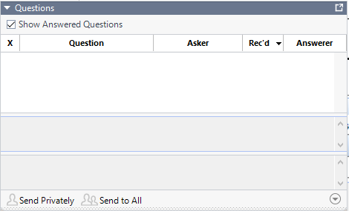
Welcome!
PLEASE MINIMIZE ALL OTHER APPLICATIONS AT THIS TIME
Asking Questions, Providing Responses
Notes:
If you have a question or comment during the presentation, you’ll be able to send it to us using the questions box located further down on your menu. Again, you can open it by clicking on the plus sign next to the word “questions.” Teri and I will be responding to these at the end of the presentation and my colleague Teri Lyn Hinds will read out questions to us at the end of the session.
If you are having technical issues, we will respond to you privately. You will need to view your control panels to see our response.

Slide 5

Welcome!
PLEASE MINIMIZE ALL OTHER APPLICATIONS AT THIS TIME
Minimizing Control Panels
Notes:
In case that menu starts to get in your way, you can hide it by clicking on the orange arrow on the top of the vertical strip of icons that hangs out there on the side of your menu. If you need it back to ask a question or to give feedback, go ahead and click on it again, and it will slide back out.

Slide 6
Thank You
You will be notified via email when the recording of this briefing is available.
Notes:
So that does it for my technical directions. We are recording this session and the recording and slides will be made available next week. You’ll be notified via email when the recording of this briefing is available.
Thanks so much for your attention, we will now move into the presentation….

Slide 7
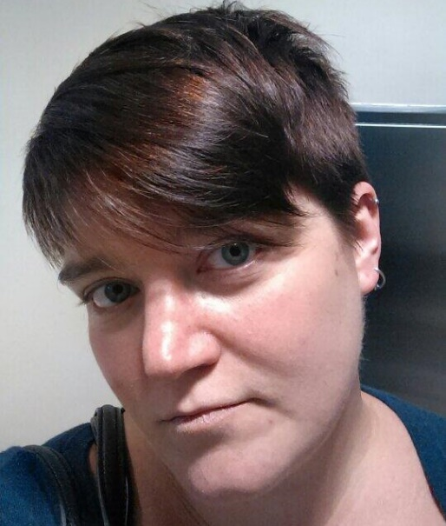

NASPA Policy & Advocacy Team
Teri Hinds
Director for Policy Research & Advocacy
thinds@naspa.org
@terilynhinds
Diana Ali
Policy Analyst
dali@naspa.org
Notes:
Introduce ourselves & give a bit of background/bio
We’re going to take a bit of a different approach to our time with you all today. Rather than focus on how we got into our roles or how others who might want to do what we do can follow in our footsteps, we’ve decided to instead talk about how all of you – no matter what or where your future career takes you – can and should be tuned into public policy conversations, how they’ll influence your day-to-day work, and how you can use your knowledge and expertise to influence public policy to better serve our students. We’re happy to connect with those of you want to do what we do as a career – feel free to email us if that’s you! – but because so much of what we do is to facilitate raising the voices of student affairs professionals, we thought today would be a good time to highlight how you can be a part of that no matter what career path you find yourself in. (And for those of you want to get wonky – we’ll get into some of that today, too, don’t worry!)

Slide 8
NASPA’s Research and Policy Institute
Connects thought leadership to policy and practice
Consults with leaders in government on key policy developments
Elevates the student affairs perspective on key policy issues
Leads initiative and policy-focused professional development opportunities for the profession
Notes:
Provide an overview of where we sit within NASPA, work of RPI as a whole
Policy & Advocacy Team works in concert with other colleagues within RPI and across NASPA as a whole to provide members overviews of key federal and state policy conversations relevant to student affairs work on campus. At the same time, we are a liaison between NASPA members and other national higher education associations working in partnership with them to inform both the field at large and policymakers about the effect of passed and proposed policies on our campuses.
Teri

Slide 9
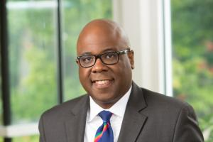
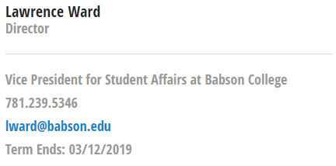
Public Policy Division
Supports NASPA’s strategic policy and advocacy goals & objectives
Representatives from each Region, a rep from the KCs, and reps from other Divisions
Monthly meetings; working to create a subcommittee structure
Notes:
One of the ways that we make sure we’re in touch with the voice of student affairs professionals is through the PPD. The PPD is one of the membership governance groups within NASPA and we are the staff liaisons to the Division. The Division consists of representatives from each of the US geographic Regions within NASPA, each of the other divisions within NASPA (the Community Colleges Division, the Small Colleges and Universities Division, and the new Equity, Inclusion, and Social Justice Division(?)), and a representative to the national Knowledge Community leadership. The Division also has at-large members, which are members asked to join or continue their work with the PPD due to their specific knowledge or expertise in a policy area of importance to the Division. In the past, at-large members have contributed expertise in areas around employment related to the Fair Labor Standards Act overtime rule and campus sexual assault response and prevention.
Dr. Lawrence Ward is the Chair of the PPD. Quote from Larry: “Now more than ever, student affairs professionals at all levels of experience need to be thoughtfully engaged in a range of policy issues that have profound implications for who can benefit from higher education. Indeed, there is considerable anxiety on our campuses related to protections for individual identity, international and undocumented students, mental and emotional health, and collective affordability.” (https://www.naspa.org/constituent-groups/posts/engagement-in-public-policy-a-note-from-division-chair-dr.-lawrence-p.-ward)
PPD Blog: https://www.naspa.org/constituent-groups/groups/public-policy-division
Plug the town hall – need to add information when it’s finalized!
Teri

Slide 10
NASPA Public Policy Agenda
Student success and college completion;
Student safety and wellness, including financial and mental wellness and protections for trans students and victims of sexual assault;
Costs of higher education, student debt, and borrower protections;
Inclusive opportunities for access and success in higher education; and
Civic engagement and freedom of expression.
Notes:
The PPD guides the development of the NASPA Public Policy Agenda, which is the agenda that governs the association’s policy efforts and attention. The agenda is approved by the NASPA Board and is admittedly and intentionally somewhat broad to reflect the breadth and diversity of the field of student affairs. The most recent version of the agenda was approved at the Board’s summer 2017 meeting and is largely in line with the previous agenda, though some of the items have been clarified and civic engagement and freedom of expression have been drawn out as their own tenet.
NASPA Public Policy Agenda: https://www.naspa.org/constituent-groups/groups/public-policy-division/initiatives/public-policy-agenda
The rest of our talk today is going take a closer look first at how you can, no matter what career you eventually decide on, engage safely and productively in public policy conversations for the benefit of your students. We’ll start by laying out some key terms and talking through ways that institutions and individuals can engage in advocacy that won’t get you into hot water. We’ll then step (quickly!) through some specific issues to give you a bit of background to start you on your journey as well as resources you can use to learn more and further your reach. It’s important to keep in mind as we go through our examples today that they’re just a few of the many issues and topics student affairs professionals work with. We strongly encourage you (shameless plug!) to subscribe to updates from the RPI blog to get regular updates and information about current policy issues effecting student affairs as a field and higher education as a whole.
Diana

Slide 11
Advocacy Options
Important Definitions
  Lobbying = taking a specific stand and/or advocating for specific action on a specific piece of legislation
  Advocacy = taking a specific stand on a specific issue without mentioning specific policy or legislation
    The lines can get blurry
    Grassroots advocacy can be lobbying if it targets specific legislation or includes a call to action!
  Policy analysis = explanation, context, and education around specific legislation without advocating a stance or action
Notes:
Let’s start with some definitions to help clarify what we’re talking about. (Notes are pretty much on the slide.)
Generally, most of the work you’ll engage with professionally will be advocacy or analysis/education. If you do engage in lobbying as part of your official duties in your job, you’ll want to be in touch with your campus government or public affairs offices so they can make sure that you’re staying in line with their messaging.
Personally, you may engage in activity around specific legislation, but it’s not considered lobbying when you’re just doing it as an individual – only when you’re representing a group or organization. We’ll get into more details on the do’s and don’ts around personal advocacy in a few minutes.
DA

Slide 12
Advocacy Options
Institutional advocacy
Faculty & staff advocacy on campus
Personal advocacy
Supporting student advocacy
Promoting civic learning and democratic engagement
Notes:
Just like there are different activities you can engage in, there are different levels at which you might engage. Your institution might take positions or stances on issues or proposed legislation, or you as faculty and staff might work internally to advocate for specific institutional policies or stances. We’ll go over a few examples – but keep in mind that the boundaries between these distinctions are not always super defined and sometimes the lines become a bit blurry.
DA

Slide 13
Advocacy Options
Institutional advocacy
  Public statements of support, sign-on to community/association letters; may count as lobbying
  Reaching out through campus Government Affairs directly to policymakers; counts as lobbying
  Intentional review of policies w/ focus on barriers for specific groups, e.g., Equity Scorecard models
  Clear communications on policy & practices
Notes:
Institutional advocacy
Positions that the institution takes officially are usually managed and handled by government affairs & senior leadership, e.g., signing on to community letters regarding funding for research support, or decisions declaring sanctuary campus
Within the context of institutional advocacy when creating campus policies and practices, paying intentional heed to equity, impacts on historically underrepresented populations, etc.
University of Southern California Center for Urban Education Equity Scorecard: https://cue.usc.edu/tools/the-equity-scorecard/
Teri

Slide 14
Advocacy Options
Faculty & staff advocacy on campus
  Become the squeaky wheel; strategically push campus conversations with stakeholders
  Create space for marginalized populations to feels safe, speak without having to disclose status
  Connect to community organizations, e.g., food banks, childcare centers, public transportation & carpooling, advocacy organizations
Notes:
Faculty/staff advocacy
Within institution advocacy - working on campus to influence campus-based policies consistent with personal beliefs, stances; using your personal influence and resources as a trusted member of your campus community to advocate for issues and populations that may not have other/strong advocates, e.g. working with undocumented students and connecting to community organizations; Larry’s blog post - public lense of policy, student-focused
In the classroom and through student support services, faculty and staff can create safe and brave spaces for marginalized students by creating challenging spaces that foster equal participation around classmates, and by offering support resources and tools through centers on campus, we will talk more about resource options in our examples later on in the presentation. Please check out NASPA’s newly released Policy in Practice whitepaper: “Safe Spaces and Brave Spaces: Historical Context and Recommendations for Student Affairs Professionals” for more information on safe and brave spaces
Education and information to support students engaged in advocacy, connecting students to student associations and organizations, like Young Invincibles or Student Veterans of America, that do direct lobbying or advocacy
DA

Slide 15
Advocacy Options
Personal advocacy drawing on your professional expertise
  Include stories from your own experience
  Disassociate from your employer: don’t use inst’l email, wear branded clothing, etc.
  Be aware of “work time” & inst’l resources (computers, wifi), especially with social media
Notes:
How can we advocate for issues/ topics we believe in personally, without jeopardizing our professional status?
You should be clear that you are not speaking as a representative of your employer or institution - that can be a statement if you're speaking, a disclaimer in social media profiles, etc.
You can establish your expertise as a student affairs professional, and use institutionally based examples (though you may want to de-identify the institution and not name any individual names) to add faces to stories/points, without implying you’re officially representing your employer
Things not to do:
Use your university email address or phone to contact legislators, engage in campaign activities or direct advocacy or lobbying
Wear any campus branded clothing while attending partisan or political events
Use University provided IT systems to engage in advocacy - possibly including work laptop to check your personal email or connecting to campus employee-only internet services
Does this look different at public vs private institutions?
Yes, in some ways, no, in others
Public institutions engaging in institutional advocacy must be conscious of their dependency on state and federal funds, need to work *with* state and federal policymakers; employees must exercise care to be good stewards of public funds - see above re don’t use institutional resources for lobbying or campaigning!
Employees at private institutions can be legally discriminated against for their public advocacy and views - within limits and the laws around this are fluid. If a private institution deems the employees views to be unaligned with their institutional mission/vision/values, they may be within their legal rights to fire them (though this is rare and must fall within federal non-discrimination laws)
Both public and private institutions are (mostly) non-profits, which limits their legal allowances for lobbying - either direct or indirect; this is generally only applicable to institutional lobbying or advocacy and we encourage people to reach out to their campus government affairs staff if they will be engaging in this type of lobbying as part of their official duties
What role does social media play in this balancing act?
Do not declare representation of institution through personal media posts, though you can use your professional experience to establish expertise
If social media boundaries are typically blurred in terms of professional/personal contacts consider creating separate/private social media to share personal beliefs
If using institutional account, avoid taking a partisan stance on issues, and stay in line with institutional vision/mission statement
Defer to the work of programs representing students impacted by policies to raise awareness on specific issues
DA

Slide 16
Advocacy Options
Supporting student advocacy
  Invite associations and organizations to come to campus
    Student Veterans of America (https://studentveterans.org/)
    United We Dream (https://unitedwedream.org/)
    Southern Poverty Law Center On Campus (http://www.splconcampus.org/)
Promote active civic engagement & democratic learning
  NASPA’s Lead Initiative, CLDE KC & annual conference
Notes:
Brief definitions:
Lobbying is taking a specific stand on a specific piece of legislation and/or advocating for specific action on a specific piece of legislation
Advocacy is taking a specific stand on a specific issue without mentioning specific policy or legislation; the lines can get blurry, though!
Grassroots advocacy can be considered lobbying - it’s just lobbying promoted by everyday citizens instead of paid lobbyists
Policy analysis is providing explanation, context, and education around specific legislation without advocating a stance or position
Civic Engagement
Ongoing commitment to civic engagement education
Connecting the campus community to issue-based resources and the advocacy organizations outside the community doing this important work
Information dissemination
Focus on voter registration and voter rights
Teri

Slide 17
Policy Examples
Immigration policy: undocumented individuals
  Deferred Action for Childhood Arrivals (DACA)
  Sanctuary campuses
Trans student rights and protection
  Title IX guidance under Obama ED (and resulting federal court cases)
  State “bathroom bill” legislation
Notes:
Let’s take a look at what each of those avenues looks like with a couple of example issues we’re keeping track of under the Public Policy Agenda: immigration policy for undocumented individuals and trans student protections. We’ll provide a brief bit of background on the policy conversation for those who may not already know it and then talk through options for advocacy on each issue.
There’s been a lot happening since the start of the year around both issues that effects our campuses and our students, so these issues will allow us to dig into policy at several levels – federal and state legislative activity as well as federal executive action. Right from the start, let’s be clear that these are not the *only* issues we’re tracking in this area, but they are good examples for us to use today to show both how policy decisions influence the day to day lives of student affairs professionals and how you all can work to influence policy conversations, both on campus and off. For information on other policy issues we’re tracking – including guns on campus, free speech & controversial speakers, and campus sexual assault prevention & response – please check out the RPI blog at www.naspa.org/rpi.
Before we jump into the details, though, it might be helpful to have some broad background on the federal and state policy environments we’re operating under right now.
Teri

Slide 18
Current Federal Policy Atmosphere
Presidential transition from Democrat to Republican
  Roll back previous “executive overreach”
  Much tighter enforcement of immigration laws
Republican control of House, Senate
  Big emphasis on deregulation: teacher ed, gainful employment, FLSA, accountability
  Preference for state control of decisions
Notes:
The broad tenets of the GOP gave us some early indication of where the Trump Administration was likely to start taking action. Traditionally, the Republican party is in favor of “smaller government” and generally focuses on enforcement of policies instead of using government to create social services. Specifically, President Trump campaigned on rolling back much of what he considered overreach by President Obama and tightening immigration enforcement.
Congressional Republicans were gearing up to have complete control of the House and Senate, given them their first opportunities to follow through on campaign promises to reduce government regulation and return control of policy implementation and decisionmaking to the states.
Teri

Slide 19
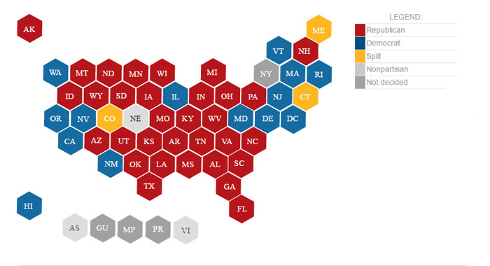
Current State Policy Overview
Source: National Conference of State Legislatures
Notes:
Recognizing GOP preferences to leave policy implementation and decision-making with the states, the composition of state legislatures has more bearing than it might under a Democrat administration. Additionally, as so much of what happens on campus is governed at the state level (at least for public institutions), understanding state legislatures will help predict the kinds of policy they are more likely to focus on and pass into law.
Maps showing legislative control: http://www.ncsl.org/research/elections-and-campaigns/2016-pre-and-post-election-state-legislative-control.aspx
Republicans control both chambers in 32 states (up from 30 in 2016); most of the middle of the country, plus NH, AK
Democrats control both chambers in 13 states (up from 12 in 2016); most of west coast, New England, except NH, ME (split)
31 (30? sources conflict) states have party “trifectas” or strongholds where one party holds the governorship, a majority in the state senate, and a majority in the state house; 25 of those are Republican controlled; map: https://ballotpedia.org/Gubernatorial_and_legislative_party_control_of_state_government
Dem: OR, CA, HI, DE, RI (maybe CT? sources conflict)
No trifecta: WA, NV, MT, CO, NM, MN, IL, LA, VA, WV, MD, NC, PA, NY, NJ, MA, VT, MA, ME
Rep: other 25 states
With that background, let’s return to our conversation around issues.
Teri

Slide 20
Immigration:
Undocumented students, DACA
Deferred Action for Childhood Arrivals (DACA) enacted 7/15/12 by Obama DHS
  Allowed undocumented immigrants to register for work permits, go to college
  Did not provide path to citizenship or legal status
DACA rescinded 9/5/17 by Trump DHS
  DACA set to expire with a 6-month delay
  Reliance on Congress to keep the program alive
Notes:
Immigration policies broadly writ include policies governing both who can enter the country, including international students, as well as who can stay in the country, with or without options to eventually become citizens. We keep track of policies in both areas as they relate to college campuses, but today we’re going to focus specifically on immigration policies around undocumented individuals, specifically, those individuals who were brought to the US by their parents as children without a legal entry status. These conversations center around a policy known as deferred action for childhood arrivals, known as DACA.
Under the Obama Administration, the Department of Homeland Security implemented DACA as an executive action to allow individuals who were brought into the US as children to register for work permits so they could legally work in the US or attend college. The program included several restrictions – such as not having committed a significant crime – and over the course of the last seven years, has allowed about 750,000 young adults to work or go to college. Many of those individuals have enrolled in college and some have even become employees within student affairs, continuing to support students like them to achieve the American dream.
However, because DACA was created through the action of an executive agency, it was also subject to reversal through the same power and the Trump Administration announced in early September that it would be ending the policy of deferred action for childhood arrivals effective March 5, 2018. This action was long anticipated, though President Trump had seemed to change his mind on how to handle DACA recipients many times since his campaign, when he promised swift action to end DACA. During the months between his inauguration and his decision to rescind DACA, the air of uncertainty around the program prompted many college campuses to declare themselves as “sanctuary campuses” in support of their undocumented immigrant students, staff, and faculty. Some states subsequently took reciprocal action to punish these campuses for what their state legislatures felt was inappropriate lack of cooperation between campuses and federal immigration officials.
In announcing the rescission of DACA, President Trump called on Congress to pass legislation that would protect undocumented immigrants that arrived as children, but, it’s unclear whether or what legislation may eventually pass.
For more on the history of DACA, see our blog post from February: RPI blog post: DACA Explained: Why it’s vulnerable under the Trump Administration - https://www.naspa.org/rpi/posts/daca-explained-why-its-vulnerable-under-the-trump-administration
DACA Set to Expire:
http://www.cnn.com/2017/09/05/politics/white-house-memo-daca-recipients-leave/index.html
DA

Slide 21
Advocacy Options
Institutional advocacy
  Encourage sign on to ACE institutional sign on letter during ACE Theme Week (10/16-20)
  Reaching out through campus Government Affairs directly to policymakers
  Intentional review of policies w/ focus on barriers for undocumented individuals
    Requirements for driver’s license or SSN?
    Scholarship opportunities
Notes:
Institutional advocacy
Positions that the institution takes officially, usually managed and handled by government affairs & senior leadership, e.g., signing on to community letters regarding funding for research support, or decisions declaring sanctuary campus
Within institution advocacy - when creating campus policies and practices, paying intentional heed to equity, impacts on historically underrepresented populations, etc.
Intentional review of policies w/ focus on barriers for undocumented individuals, are these policies still relying on DACA, many policies such as in-state tuition will need to be reworked now that DACA has been rescinded and will not provide students with work permits and SSN
Requirements for driver’s license or SSN?
Scholarship opportunities
University of Southern California Center for Urban Education Equity Scorecard: https://cue.usc.edu/tools/the-equity-scorecard/
Teri

Slide 22
Advocacy Options
Institutional advocacy
  Clear communications on policy & practices
    Campuses can protect undocumented individuals w/o declaring “sanctuary”
    Campuses considered “sensitive locations” by ICE
    Local/campus police not required to assist ICE/DHS (except where prohibited by state law , e.g., Texas SB 4)
Notes:
RPI Sanctuary Campuses Post: https://www.naspa.org/rpi/posts/sanctuary-the-status-of-campus-protections-for-immigrants-and-undocumented
Washington Post on sanctuary cities: https://www.washingtonpost.com/graphics/national/sanctuary-cities/
Brookings Institute on sanctuary cities: https://www.brookings.edu/blog/unpacked/2017/02/24/sanctuary-cities-and-trumps-executive-order/
11 states considered 18 anti-sanctuary bills
Anti-Sanctuary Legislation enacted in IN, MS, TX
Indiana SB 423 prohibits funding for institutions declaring sanctuary status
Mississippi SB 2710 revokes funding from sanctuary cities, agencies, and institutions
Texas SB 4 creates cooperation between local law enforcement, including campus enforcement, and ICE.
Blocked from going into effect by federal judge
In the past few months, we have seen 11 states consider 18 pieces of anti-sanctuary legislation that would affect college campuses. 6 states have introduced (pro) sanctuary legislation that extends to college campuses. Of this legislation, 9 pieces have failed, and 15 are pending, and 4 have been enacted. PA HB 14 was removed from the table on 06/22/2017. CA SB 54, a statewide sanctuary bill is in Assembly and was set for its first hearing on 08/23/2017 and placed on suspense file.
RPI post on sanctuary campuses: https://www.naspa.org/rpi/posts/sanctuary-the-status-of-campus-protections-for-immigrants-and-undocumented
Sanctuary Campuses now illegal under IN law:
http://indianapublicmedia.org/stateimpact/2017/05/03/sanctuary-campuses-illegal-indiana-law/
IN SB 423 (https://s3.amazonaws.com/fn-document-service/file-by-sha384/cb6b72c3c3868c4b5f05369ddfeba155c5565b38e786e7ea401c79a09ed6386f54140e71049fa3f96a24e614ef867339)
No sanctuary for undocumented immigrants (MS):
-https://mississippitoday.org/2017/03/27/anti-sanctuary-cities-bill-signed-into-law/
-MS SB 2710 (http://billstatus.ls.state.ms.us/documents/2017/html/SB/2700-2799/SB2710SG.htm)
TX targets sanctuary cities:
-http://www.npr.org/sections/thetwo-way/2017/05/08/527344804/texas-gov-abbott-signs-measure-targeting-sanctuary-cities
-TX SB 4 (https://s3.amazonaws.com/fn-document-service/file-by-sha384/1c0475c6a7ce4c54bf6f7b519a44e88fb39772de027a512c7179e21961370223adccd92f5fd012c5913c27c8d3afffff)
-TX SB 4 Blocked from implementation: https://www.bloomberg.com/news/articles/2017-08-31/texas-s-harsh-sanctuary-city-ban-blocked-by-federal-judge
Pro-Sanctuary Legislation
6 states have introduced sanctuary city legislation that extend to college campuses.
4 states have pending statewide sanctuary legislation (CA, CT, IL, NV)
NY enacted pro-sanctuary
ICE’s sensitive locations policy: https://www.ice.gov/doclib/sevis/pdf/bcm1703-05.pdf
“enforcement actions at sensitive locations should generally be avoided, and requires either prior approval from an appropriate supervisory official or exigent circumstances necessitating immediate action”
ILRC Immigration Detainers Legal Update (local/campus police not required to detain): https://www.ilrc.org/sites/default/files/resources/detainers_legal_update_october_2016.pdf
Teri

Slide 23
Advocacy Options
Institutional advocacy
  Data do not have to just be shared
    FERPA laws: disclosure of student personally identifiable information (PII) to “comply with a judicial order or lawfully issued subpoena” (ICE detainers are not judicial orders)
Notes:
RPI Sanctuary Campuses Post: https://www.naspa.org/rpi/posts/sanctuary-the-status-of-campus-protections-for-immigrants-and-undocumented
Washington Post on sanctuary cities: https://www.washingtonpost.com/graphics/national/sanctuary-cities/
Brookings Institute on sanctuary cities: https://www.brookings.edu/blog/unpacked/2017/02/24/sanctuary-cities-and-trumps-executive-order/
11 states considered 18 anti-sanctuary bills
Anti-Sanctuary Legislation enacted in IN, MS, TX
Indiana SB 423 prohibits funding for institutions declaring sanctuary status
Mississippi SB 2710 revokes funding from sanctuary cities, agencies, and institutions
Texas SB 4 creates cooperation between local law enforcement, including campus enforcement, and ICE.
Blocked from going into effect by federal judge
In the past few months, we have seen 11 states consider 18 pieces of anti-sanctuary legislation that would affect college campuses. 6 states have introduced (pro) sanctuary legislation that extends to college campuses. Of this legislation, 9 pieces have failed, and 15 are pending, and 4 have been enacted. PA HB 14 was removed from the table on 06/22/2017. CA SB 54, a statewide sanctuary bill is in Assembly and was set for its first hearing on 08/23/2017 and placed on suspense file.
RPI post on sanctuary campuses: https://www.naspa.org/rpi/posts/sanctuary-the-status-of-campus-protections-for-immigrants-and-undocumented
Sanctuary Campuses now illegal under IN law:
http://indianapublicmedia.org/stateimpact/2017/05/03/sanctuary-campuses-illegal-indiana-law/
IN SB 423 (https://s3.amazonaws.com/fn-document-service/file-by-sha384/cb6b72c3c3868c4b5f05369ddfeba155c5565b38e786e7ea401c79a09ed6386f54140e71049fa3f96a24e614ef867339)
No sanctuary for undocumented immigrants (MS):
-https://mississippitoday.org/2017/03/27/anti-sanctuary-cities-bill-signed-into-law/
-MS SB 2710 (http://billstatus.ls.state.ms.us/documents/2017/html/SB/2700-2799/SB2710SG.htm)
TX targets sanctuary cities:
-http://www.npr.org/sections/thetwo-way/2017/05/08/527344804/texas-gov-abbott-signs-measure-targeting-sanctuary-cities
-TX SB 4 (https://s3.amazonaws.com/fn-document-service/file-by-sha384/1c0475c6a7ce4c54bf6f7b519a44e88fb39772de027a512c7179e21961370223adccd92f5fd012c5913c27c8d3afffff)
-TX SB 4 Blocked from implementation: https://www.bloomberg.com/news/articles/2017-08-31/texas-s-harsh-sanctuary-city-ban-blocked-by-federal-judge
Pro-Sanctuary Legislation
6 states have introduced sanctuary city legislation that extend to college campuses.
4 states have pending statewide sanctuary legislation (CA, CT, IL, NV)
NY enacted pro-sanctuary
ICE’s sensitive locations policy: https://www.ice.gov/doclib/sevis/pdf/bcm1703-05.pdf
“enforcement actions at sensitive locations should generally be avoided, and requires either prior approval from an appropriate supervisory official or exigent circumstances necessitating immediate action”
ILRC Immigration Detainers Legal Update (local/campus police not required to detain): https://www.ilrc.org/sites/default/files/resources/detainers_legal_update_october_2016.pdf
Teri

Slide 24
Advocacy Options
Faculty & staff advocacy on campus
  Provide services to students, staff, & faculty
    Referrals to free legal clinics
    Partner with community agencies, e.g., United We Dream
  Tell the stories of DACA recipients to public, policy makers
    Beware of “the good immigrant” narrative – undocumented immigrants deserve human rights
  Join NASPA Undocumented Immigrants and Allies KC
Notes:
Undocumented Immigrants and Allies KC: https://www.naspa.org/constituent-groups/kcs/undocumented-immigrants-and-allies
Audit academic program requirements for challenges or barriers
Forms asking about citizenship status, SSN, etc.
Compilation of “safe” faculty and staff who are knowledgeable and can support students
Trainings to ensure that students feel safe in classroom (insensitive comments)
Ensure that opportunities and experiences are equitable regardless of immigration status
While avoiding a good vs. bad immigrant narrative. All immigrants deserve basic human rights, regardless of status.
RPI Public Policy Briefing on DACA and Undocumented Students: You can access the slides and a recording of the briefing, along with an FAQ with additional resources for supporting undocumented individuals on campus, from the NASPA Online Learning Center: https://olc.naspa.org/
If you’re not already registered for the Public Policy Briefing Series, you’ll need to register: https://olc.naspa.org/catalog/naspa-policy-briefing-series
Once registered, you can access the series by logging into the NASPA Online Learning Center. You’ll need to sign in with your NAPSA user name and password (if you aren’t still logged in from when you registered), and will then see your dashboard.
For most people, the dashboard will bring you automatically to your “enrolled” events, and you should see “NASPA Policy Briefing Series” in that list. If not, you can click on “Enrolled” from the menu in the upper center of the page and select it from there.
DA

Slide 25
Advocacy Options
Personal advocacy drawing on your professional expertise
  ACE Theme Week website will have links to contact your Congressional delegation
  Use personal social media to educate friends & family, share information, encourage outreach
  Take care not to “out” someone unintentionally – get permission!
Notes:
Proposed legislation to protect Dreamers
DREAM Act 2017
BRIDGE Act
American Hope Act 2017
Recognizing America’s Children Act
Proposed legislation to reform immigration
David Oliver Act
DREAM ACT
-Primary Sponsors: Sen. Lindsey Graham (R-SC) and Sen. Richard Durbin (D-IL)
-Latest Action: Introduced to the Senate on 07/19/2017, bill text availability to the public in progress
The Dream Act would allow these young people to earn lawful permanent residence and eventually American citizenship if they:
Are longtime residents who came to the U.S. as children;
Graduate from high school or obtain a GED;
Pursue higher education, work lawfully for at least three years, or serve in the military;
Pass security and law enforcement background checks and pay a reasonable application fee;
Demonstrate proficiency in the English language and a knowledge of United States history; and
Have not committed a felony or other serious crimes and do not pose a threat to our country.
Before August recess, two different bills got introduced to address the status of DACA recipients — in addition to the two that were introduced during previous DACA scares.
American Hope Act
In an effort unveiled Friday, members of the Congressional Hispanic Caucus (among 117 original co-sponsors) introduced the American Hope Act in late July, which would open a pathway to citizenship for “DREAMers” — young immigrants who arrived in the country before their 18th birthday and before December 31, 2016 who meet certain conditions.
BRIDGE Act: https://www.nilc.org/issues/daca/faq-bridge-act/
Some of the bills are more bipartisan than others; House Democrats’ American Hope Act is the broadest bill yet proposed to deal with the DREAMers, while the Recognizing America’s Children (RAC) Act from a group of moderate House Republicans places moderate restrictions on DREAMers before they’re allowed to get green cards. (In the center, and appropriately bipartisan, are the latest versions of the DREAM Act introduced in the House and Senate.) Fundamentally, though, the bills are pretty similar: All of them would allow people who currently have protections under DACA to apply for full legal status in the US and eventually be allowed to become American citizens.
The White House has already indicated that President Trump wouldn’t sign such a bill as a stand-alone. Most members of this faction, though, would privately admit that they’re willing to pair protections for the DREAMers with some immigration enforcement measures.
The Davis-Oliver Act would be a big step up for immigration enforcement, but not quite as aggressive as making the E-Verify system (which checks the legal status of workers and applicants) mandatory for all employers in the US.
The RAISE Act is a broader transformation of immigration policy (in the context of past immigration debates)
Priority would instead be given based on a scorecard of certain identifying traits such as ability to speak English, income prospects, and job skills. These priorities are similar to those of immigration law prior to 1965 which limited entrance to non-white groups.
DA

Slide 26
Advocacy Options
Supporting student advocacy
  Invite associations and organizations to come to campus
    United We Dream (https://unitedwedream.org/)
    Southern Poverty Law Center On Campus (http://www.splconcampus.org/)
  Remind students that undocumented immigrants are especially vulnerable right now – take care not to cause unintentional harm
Notes:
Provide “Know Your Rights” workshops (train the trainee)
Compile list of organizations in the community who are providing these services to families in the community
Teri

Slide 27
Trans Student Protections: Federal
Executive and Judicial Actions
ED & Justice DCL rescinding Obama ED guidance for trans students
  March 2017: Gloucester County School Board v. GG Case referred back to 4th Circuit Appeals Court
  May 2017: 7th Circuit Appeals Court Decision upholds Title IX prohibitions against sex discrimination in Whitaker v. Kenosha Unified School District
  June 2017: OCR changes procedure on complaints regarding trans students
Notes:
PPD Blog Post: Trump Administration’s Reversal of Transgender Student Protections and Higher Educations Response – https://www.naspa.org/constituent-groups/posts/trump-administrations-reversal-of-trans-student-protections-and-response
June 2016 Dear Colleague Letter - https://www2.ed.gov/about/offices/list/ocr/letters/colleague-201605-title-ix-transgender.pdf
February 2017 Dear Colleague Letter - https://www.justice.gov/opa/press-release/file/941551/download
NASPA President Kruger’s response to February 2017 DCL: https://www.naspa.org/about/blog/dr.-kruger-responds-to-dear-colleague-letter-rescinding-transgender-student
Gloucester Count School Board v. GG
SCOTUS remanded the case back to 4th Circuit Court of Appeals following DCL: http://www.nbcnews.com/news/us-news/u-s-supreme-court-rejects-transgender-rights-case-n729556
Future of case, other cases re trans rights: https://www.msn.com/en-us/news/us/gavin-grimm-vows-to-continue-fighting-for-transgender-rights/ar-AAnUPnN
Evancho, et al. v Pine-Richland School District, et al.: http://www.washingtonblade.com/2017/02/27/court-rules-in-favor-of-jackie-evancho/
PA District Court found in favor of 3 trans students
Argument made on Title IX but judge decided it under 14th Amendment (Equal Protection)
Whitaker v. Kenosha Unified School District
(Ashton Whitaker) The U.S. Court of Appeals for the 7th Circuit ruled Tuesday that Kenosha Unified School District No. 1 in Wisconsin violated the transgender student’s civil rights by refusing to let him use the boys’ bathroom. The unanimous ruling by a three-judge panel upheld a preliminary injunction granted by a lower court giving him access to the boys’ restrooms while his case is being tried. Mr. Whitaker was likely to win, the panel determined. Most significantly, the court’s sweeping finding held that his rights were violated under the 14th Amendment of the Constitution and Title IX prohibitions against sex discrimination in federally funded schools.
Similar reasoning was the basis for a legal guidance issued to schools last year by the Obama administration affirming protections for transgender students, including the right to use school restrooms and locker rooms that conformed with their gender identity. It sparked a backlash from critics who called it federal overreach, and the Trump administration was quick to rescind it, arguing that how transgender students are treated should be left to state and local decision-makers. The move prompted the Supreme Court not to hear scheduled arguments in a case (of Virginia student Gavin Grimm) in which the guidance was a major factor. The 7th Circuit decision, without mentioning the guidance, bears out the contention of Obama officials that they were not making new law but rather enforcing existing law. Ultimately the issue will be decided by the Supreme Court.
Internal memo to Regional Directors June 6, 2017 OCR Guidance: re complaints involving transgender students
“OCR should rely on Title IX and its implementing regulations, as interpreted in decisions in federal courts and OCR guidance documents that remain in effect, in evaluating complaints of sex discrimination against individuals whether or not the individual is transgender.”
Concerns regarding OCR:
Secretary DeVos suggests that civil rights protections should be the province of the states: http://thehill.com/blogs/floor-action/senate/318202-booker-no-confidence-on-devoss-support-for-civil-rights-office
Acting Assistant Secretary for Civil Rights Candice Jackson appointed on April 12, 2017: https://www.propublica.org/article/devos-candice-jackson-civil-rights-office-education-department
Concerns regarding the Trump Administration’s actions related to civil rights across the federal government: https://www.washingtonpost.com/politics/trump-administration-plans-to-minimize-civil-rights-efforts-in-agencies/2017/05/29/922fc1b2-39a7-11e7-a058-ddbb23c75d82_story.html?tid=sm_tw&utm_term=.65daa0748652
Teri

Slide 28
Title IX: Trans Protections
Executive and Judicial Actions
August 2017: Trans individuals barred from military service
  National Center for Lesbian Rights (NCLR), GLBTQ Legal Advocates & Defenders (GLAD) filed suit
  October 2017: AG Sessions moved to dismiss NCLR/GLAD lawsuit
Obama DOJ (2014) & federal courts extend Title VII anti-discrimination laws in employment to sexual orientation and gender identity
  October 2017: AG Sessions memo reverses stance; overturned 2014 Obama guidance
Notes:
Trans military ban: http://www.cnn.com/2017/08/25/politics/trump-transgender-military/index.html
DOJ movement to dismiss court case: http://abcnews.go.com/Politics/trump-administration-moves-dismiss-lawsuit-transgender-military-ban/story?id=50310395
“The National Center for Lesbian Rights (NCLR) and GLAD filed the lawsuit against the ban in federal court in Washington, D.C., on Aug. 9, 2017, after Trump announced his policy change in a tweet the month before.
On July 26, Trump said in a Tweet that transgender people will not be allowed to serve in the U.S. military "in any capacity."
On Aug. 31, 2017, the civil rights groups filed for a preliminary injunction to immediately stop the ban and added two named plaintiffs to the case, Dylan Kohere and Regan Kibby.”
The 11th, 9th, 6th and 1st circuit courts have all ruled that Title VII anti-discrimination laws in employment extend to sexual orientation and gender identity.
Session memo on Title VII: http://www.cnn.com/2017/10/05/politics/jeff-sessions-transgender-title-vii/index.html
State bathroom bills – see next slide
Teri

Slide 29
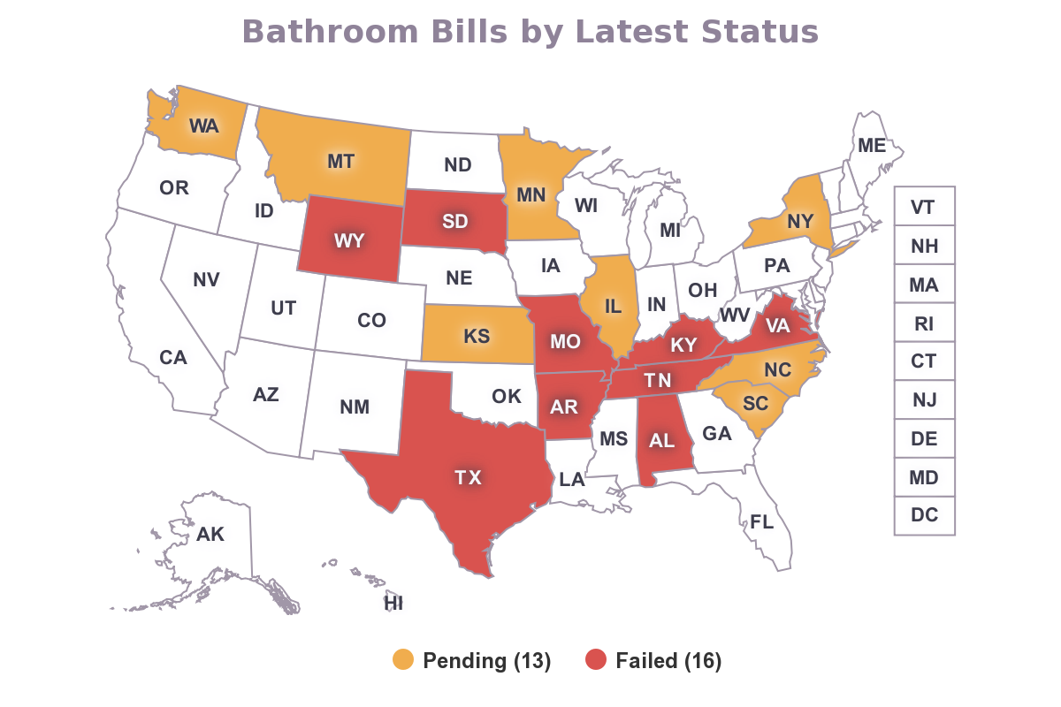
Notes:
RPI Blog Post: State Legislative Analysis: Bathroom Bills - https://www.naspa.org/rpi/posts/state-legislative-analysis-bathroom-bills
2016-2017 16 states filed 29 bills
13 of these bills still pending, but stalled in committee
Texas
HB 46 & HB 50 were of concern during special session and similar legislation may be introduced in the next legislative cycle
TX HB 46- would forbid political subdivisions from passing antidiscrimination measures
TX HB 50-identical, but in application to a school board
March 2016: NC enacts HB2 “Public Facilities Privacy and Securities Act”
HB2 rescinded, replacement legistlation
-- It effectively maintains a key feature of HB2 by leaving regulation of bathroom access solely in control of the Legislature.
-- It prevents local governments, until December 2020, from passing or amending their own nondiscrimination ordinances relating to private employment and public accommodation. Therefore we may see the re-emergence of bills styming the creation of nondiscrimination ordinances at the local level in the next legislative cycle, which is essentially a bathroom bill in disguise.
Industry response is largely negative
Obama Admin files suit, labels legislation unconstitutional & in violation of Civil Rights Act and Title IX
Trump Admin is expected to drop the suit: http://www.citizen-times.com/story/news/2017/03/06/justice-department-backs-request-halt-hb/98809302/
2017: Bills in other states face pushback, but due to Republican controlled legislatures are moving through
16 states have filed 23 bills; TX SB 6 has passed out of the first chamber yet; TX SB 2078 has passed the second chamber. SD SB115 was withdrawn, WY HB 244 & VA HB 1612 failed prior to introduction, and TN SB 771 failed in the Senate Education Committee.
Language stipulated in this legislation differs across the states in definitions of “sex” and “gender,” targeted institutions, alternative options and exceptions, and handling of noncompliance.
See RPI blog post above for additional analysis
Texas news:
While the Policy and Advocacy Team at NASPA has been watching for movement of TX HB 46 and TX HB 50 during Texas Special Session, both failed to move forward by the end date of 8/16/2017. These bills mimic failed legislation HB 2899, a slightly more lenient form of the original TX SB 6 Bathroom Bill. TX HB 46 would forbid “political subdivisions, including a public school district” from adopting or enforcing measures to “protect a class of persons from discrimination” in regulating “access to multi-occupancy restrooms, showers or changing facilities.” HB 50 was identical except applying only to a school district board. In the past few months other states have retreated from the conversation. Additional bills of this kind are unlikely to be introduced during the 2016-2017 legislative session.
https://www.usnews.com/news/best-states/articles/2017-05-30/texas-bathroom-bills-fate-hangs-on-special-session
http://www.thedailybeast.com/articles/2017/05/22/texas-is-on-the-verge-of-passing-two-horribly-anti-lgbt-laws
https://www.texastribune.org/2017/05/21/amid-special-session-threat-house-eyes-bathroom-restrictions-schools/
TX SB 2078 (https://s3.amazonaws.com/fn-document-service/file-by-sha384/54458f64f12d80db134b6fdc274266c58cd0df04d695b6e6ae4823f751faa9210720d6fe5832300a613741ff7f06607e
RPI Blog Post: State Legislative Analysis: Bathroom Bills - https://www.naspa.org/rpi/posts/state-legislative-analysis-bathroom-bills
NCSL: http://www.ncsl.org/research/education/-bathroom-bill-legislative-tracking635951130.aspx
Trans Inclusiveness session slides can be accessed on the NAPSA website along with other materials from Annual: https://www.naspa.org/events under “Presentation Archive”
Seeing a trend of gender identity and/or sexual orientation added to state non-discrimination laws; do not have a definitive list
Language in bills related to education and/or housing in at least a dozen states; 19 total bills, 17 pending, 2 failed & most are predicted not to be enacted
NH: http://www.wmur.com/article/nh-house-considers-adding-transgender-protections-to-anti-discrimination-laws/8961835
DA

Slide 30
Advocacy Options
Institutional advocacy
  Public non-discrimination statements in admissions, housing, hiring
  Reaching out through campus Government Affairs directly to ED OCR staff
  Intentional review of policies w/ focus on barriers for trans individuals
    Availability of gender-neutral facilities (restrooms, locker rooms) & housing
    Do you ask for gender when you don’t need it?
    Policies around chosen names, pronouns
Notes:
Institutional advocacy
Positions that the institution takes officially, usually managed and handled by government affairs & senior leadership, e.g., signing on to community letters regarding funding for research support, or decisions declaring sanctuary campus
Within institution advocacy - when creating campus policies and practices, paying intentional heed to equity, impacts on historically underrepresented populations, etc.
Lambda Legal Supporting Trans Students: https://www.lambdalegal.org/know-your-rights/article/trans-supporting-students
Umass Amherst Stonewall Center Necessary Practices for Supporting Trans Students presentation: https://www.umass.edu/stonewall/sites/default/files/faculty_spring_17.pdf
Campus Pride Trans Policy Clearinghouse: https://www.campuspride.org/tpc/
Teri

Slide 31
Advocacy Options
Faculty & staff advocacy on campus
  Provide services to students, staff, & faculty
    Referrals to free legal clinics, name change resources, e.g., Lambda Legal, Transgender Law Center
  Host a study group w/ Dr. Z Nicolazzo’s Trans* Studies in Higher Education syllabus: https://t.co/P0aakMbve0
  Follow NASPA Equity, Inclusion, & Social Justice Division
Notes:
Lambda Legal: https://www.lambdalegal.org/
Transgender Law Center: https://transgenderlawcenter.org/
National Center for Transgender Equality: http://www.transequality.org/issues/youth-students
Campus Pride: https://www.campuspride.org/
Dr. Z Nicolazzo’s Trans* Studies in Higher Education syllabus: https://docs.google.com/document/d/1uUFd5pMlLTOigvVtt9uJYmimhH2w4rZL9azrrUiqZJc/edit
Teri

Slide 32
Advocacy Options
Personal advocacy drawing on your professional expertise
  Outreach to ED Office of Civil Rights, Department of Justice, state elected officials
  Use personal social media to educate friends & family, share information, encourage outreach
  Attend events, be visible as an ally
Notes:
Teri

Slide 33
Advocacy Options
Supporting student advocacy
  Invite associations and organizations to come to campus
    Southern Poverty Law Center On Campus (http://www.splconcampus.org/)
Notes:
Teri

Slide 34
NASPA RPI/PPD Resources
Weekly posts to the RPI blog (naspa.org/RPI)
  Monday: Policy News Round-up
  Thursday: Topical issue analysis/update
Monthly Public Policy Briefing Series
  Sign up through the NASPA OLC
Monthly PPD blogs – voices from the field
Quarterly White Papers/Policy Briefs
  Safe Spaces/Brave Spaces just released!
Notes:
Weekly News Update to the RPI Blog posted on Mondays
Monthly Public Policy Briefing series (2nd to *last* Thursday): https://olc.naspa.org/catalog/naspa-policy-briefing-series
Teri

